Slide 1

The what if of ncaa basketball 2020

Slide 2


Due to the COVID 19 there was no ncaa basket ball tournament in 2020
Leaving many jonesing for march madness

Slide 3
What is March Madness?
The NCAA Division I men’s basketball tournament is a single-elimination tournament of 68 teams that compete in seven rounds for the national championship.
The inaugural tournament had just eight teams, and saw Oregon beat Ohio State 46-33 for the title
It has been played annually since 1939.
This is the first time ever that it has been cancelled

Slide 4
How are the Teams Selected
The 32 Division I conferences all receive an automatic bid, which they each award to the team that wins the postseason conference tournament
The 10-member NCAA Men's Division I Basketball Committee is responsible for selecting

Slide 5
Committee Rules
The committee selects the 36 best teams not otherwise automatic qualifiers for their conference to fill the at-large berths. There is no limit on the number of teams the committee may select from one conference;
The committee endeavors to achieve reasonable competitive balance in each region of the bracket;
A committee member (“member”) shall not be present during any discussion regarding the selection or seeding of a team the individual represents as an athletics director or commissioner;
A member is permitted to answer only general, factual questions about teams in the conference the individual represents;
At no point in the process shall a member vote for a team the individual represents as an athletics director or commissioner;

Slide 6
Committee Rules
A committee member shall not be present during any discussion regarding the selection or seeding of a team in which an immediate family member is a student-athlete on the men’s basketball team, is a member of the men’s basketball coaching staff or is a senior athletics administrator at the institution (however upon returning to the room committee members will be updated on relevant discussion by the NCAA’s vice president of men’s basketball);
At no point in the process shall a member vote for a team in which an immediate family member is a student-athlete on the men’s basketball team, is a member of the men’s basketball coaching staff or is a senior athletics administrator at the institution;
All votes will be by secret ballot.

Slide 7
NO STANDARD MEASUREMENT FOR SELECTING TEAMS??
“AP ranking – The Associated Press has been ranking the top basketball teams since 1948. In its current form, the poll ranks the top 25 teams in Division I via a ranking that is compiled from the ballots of 65 sports journalists across the country. The ranking has no official weight in the selection process, and even a No. 1 ranking in the AP poll does not technically guarantee a team a bid to the NCAA tournament.” -NCAA Offical website
“BPI — College Basketball’s Power Index, invented by ESPN, is a statistic that measures how far above or below average every team is, and projects how well the team will do going forward. The index uses two measurements to do this: BPI Offense (measure of a team’s offensive strength compared to an average offense) and BPI Defense (measure of a team’s defensive strength compared to an average defense). BPI is calculated by finding the difference between these two measurements.” NCAA Offical website

Slide 8
OUR DATA
We have team records from the 2014-15 season to the early end of 2019-20 season
We will be using 80% of the data to from 2014-15 to 2018-19 to train the prediction model
We will be using 20% of the data to from 2014-15 to 2018-19 to test our predictions
We will use the information from the 2019-20 season up till its cancelation to predict who might have been in this year’s tournament

Slide 9
Linear Regression Model WAS THE BEST Predictor
G: Number of games played
W: Number of games won
BARTHAG: Power Rating
TOR: Turnover Percentage Allowed
ORB: Offensive Rebound Percentage
DRB: Defensive Rebound Percentage
FTR: Free Throw Rate
2P_O: Two-Point Shooting Percentage
2P_D: Two-Point Shooting Percentage Allowed

Slide 10
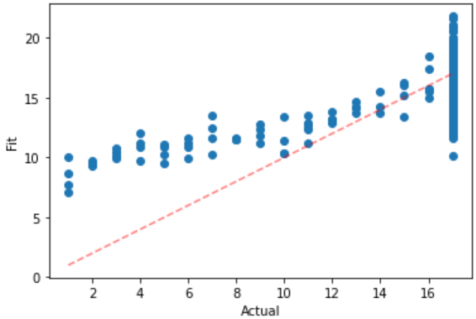
R- Squared: 0.452

Slide 11
 | Predicted 0 | Predicted 1
Actual 0 | 269 | 0
Actual 1 | 2 | 65
 | Precision | Recall | F1-Score
False | 0.99 | 1.00 | 1.00
True | 1.00 | 0.97 | .98
ACCURACY
Macro Avg | 1.00 | 0.99 | 0.99
Weighted Avg | 0.99 | 0.99 | 0.99

Slide 12
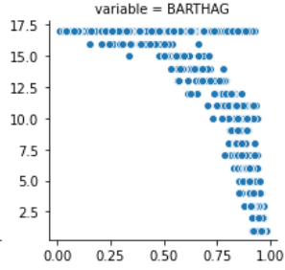
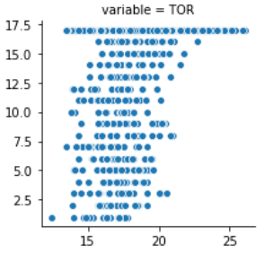
COLUMN | COEFFICENT | P-Value
GAMES | -0.2847 | 0.00
WINS | -0.1746 | 0.00
BARTHAG | -4.8798 | 0.00
TURNOVER RATE | -0.0035 | 0.95
OFFENSIVE REBOUNDS | -0.0571 | 0.019
DEFENSIVE REBOUNDS | -0.0938 | 0.001
FREE THROW RATE | 0.0464 | 0.009
2-POINT % | 0.0462 | 0.178
2-POINT % ALLOWED | -0.0207 | 0.533
3-POINT % ALLOWED | -0.0693 | 0.095

Slide 13
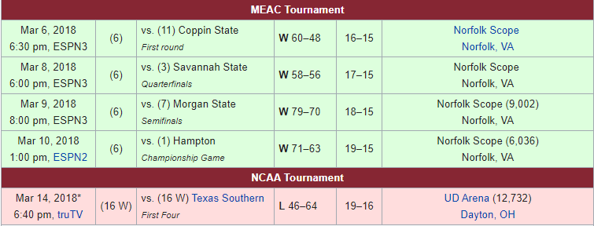
2017–18 North Carolina Central Eagles men's basketball team

Slide 14
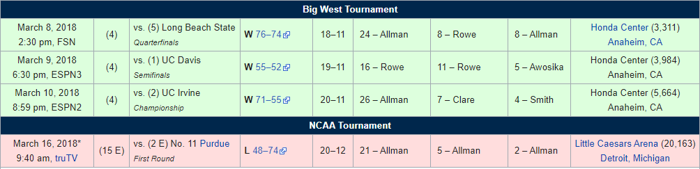
2017–18 Cal State Fullerton Titans men's basketball team

Slide 15
Our theoretical Bracket
Using our prediction model I picked the lowest 64 predictions (ignored “first four” part of the tournament)
I seeded them based of their rank in the data
Our prediction determined winner
Made some interesting upsets

Slide 16


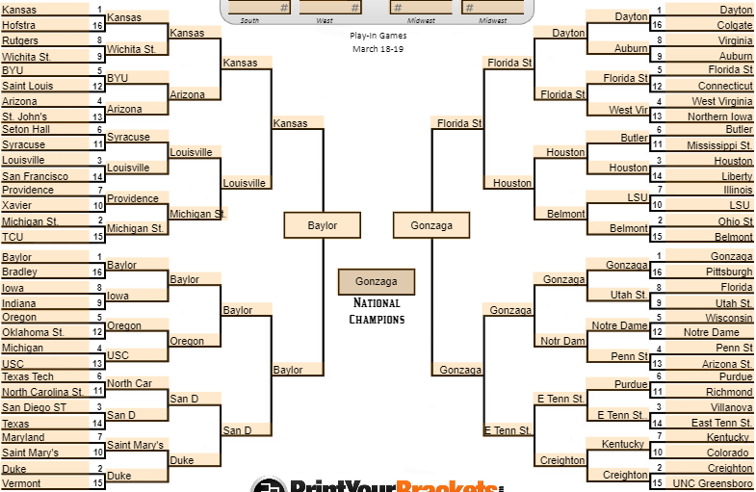




Slide 17
MODEL PREDICT TEST TOP 3 AND HOW THEY PLACED IN THE NCAA TOURNAMENT
North Carolina (2017 team) was lowest seed number in our test set and that year they were NCAA Champions
Kansas (2018 team) was second lowest seed number in our test set and that year they made it to the final four (our test set didn’t have Michigan’s or Villanova’s 2018 team in it)
Oregon (2017 team) was third lowest seed number in our test set and that year they made it to the final four losing to North Carolina

Slide 18
CONCULSION
GOOD PREDICTION MODEL FOR GETTING INTO NCAA TOURNEMENT
BAD FOR PREDICTING ACTUAL SEED NUMBER DUE TO LARGE AMOUNT OF TEAMS NOT GETTING INTO TOURNAMENT
AT FIRST GLACE MAY BE A GOOD PREDICTOR AT HOW FAR A TEAM WOULD GO BUT NEEDS FURTHER TESTING

